Slide 1
Name : Kafeel Ahmad Butt (SP16-BCS-187) Subject : Machine Learning Topic : Classification

Slide 2
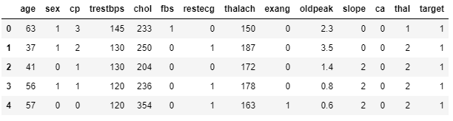
Learning Problem
We have a data which classified if patients have heart disease or not according to features in it. We will try to use this data to create a model which tries predict if a patient has this disease or not.
Dataset

Slide 3
Dataset Description
Data contains
age - age in years
sex - (1 = male; 0 = female)
cp - chest pain type
trestbps - resting blood pressure (in mm Hg on admission to the hospital)
chol - serum cholestoral in mg/dl
fbs - (fasting blood sugar > 120 mg/dl) (1 = true; 0 = false)
restecg - resting electrocardiographic results

Slide 4
Dataset Description (Continued)
thalach - maximum heart rate achieved
exang - exercise induced angina (1 = yes; 0 = no)
oldpeak - ST depression induced by exercise relative to rest
slope - the slope of the peak exercise ST segment
ca - number of major vessels (0-3) colored by flourosopy
thal - 3 = normal; 6 = fixed defect; 7 = reversable defect
target - have disease or not (1=yes, 0=no)

Slide 5
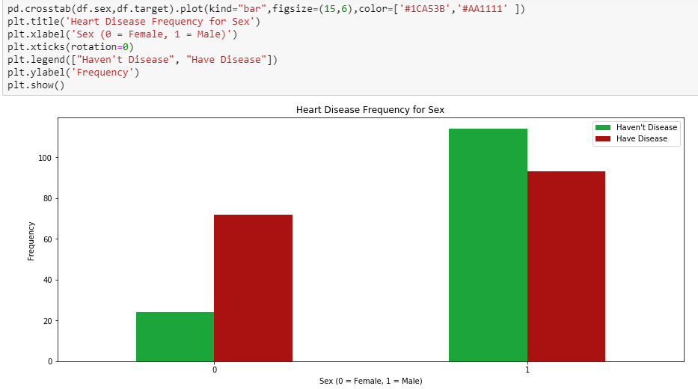
Data Exploration with charts
Graphs are easy so I will check how many patients have disease according to their age.
Like this I have also check other visualizations with target and other variables.

Slide 6





ML Techniques and Evaluation Measures
Algorithms
Logistic Regression
K-Nearest Neighbors (KNN) with best k value
Support Vector Machine (SVM)
Naive Bayes Algorithm
Decision Tree Algorithm
Random Forest Classification

Slide 7
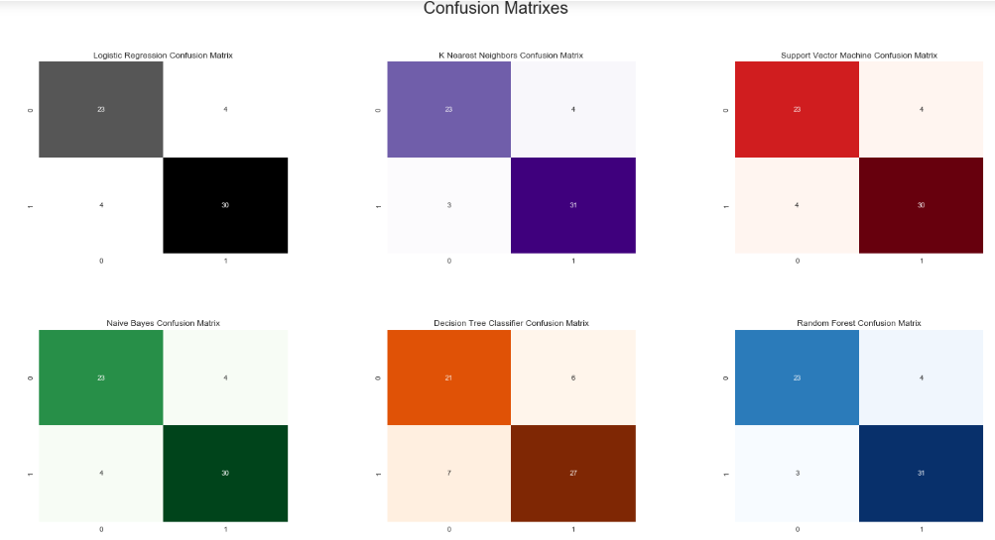
Evaluation Measures
Accuracy Score
is used to evaluate
ML algorithms.
Confusion Matrix
is also another
evaluation measure
shown in this figure.

Slide 8
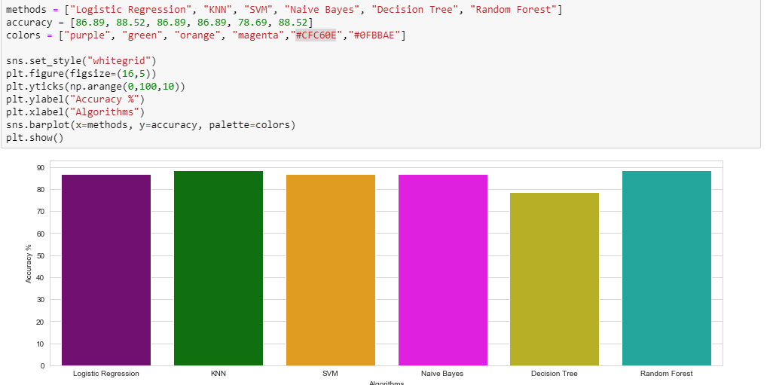
Comparing Models

Slide 9
Jazak Allah

